Slide 1


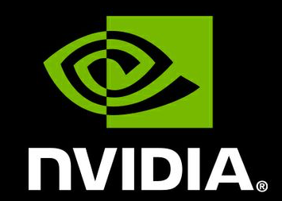
Chest X-Ray Computer Aided Diagnosis
Anuroop Mrutyunjay, Pragnya Kondrakunta, P.B. Pranav Kumar
Registration ID: AIH19T-0136
Organization: Osmania University
Mail-id: m98jay@gmail.com

Slide 2
About Us
Anuroop Mrutyunjay
Visit: anuroopshannu.me
Anuroop Mrutyunjay is an entrepreneur, web, AI and IoT developer. He is the founder of FoGR Technologies (Recognized by Startup India) and has graduated the YCombinator California startup accelerator program. Currently, he is pursuing research at Osmania University under Dr. Hemalatha Rallapalli.
He has a patent pending in the area of deep learning and IoT and has published multiple papers in renowned international journals including Springer. He has successfully completed 25 technology projects in a timespan of two years. A curated list of his projects include:
Non-Max Suppression for Real-time Human Localization in LWIR
Published in the Springer Journal for implementation of YOLOv3 on real-time thermal camera feed for the localization of Humans.
Third Eye - A Unified system of Assistance for the blind
A consolidation of various features such as object detection, voice assistance, geofence etc. developed using custom deep learning algorithms & Microsoft Cognitive Services.
Autonomous rover using Deep Tech.
Developed the algorithms and power house modules for a POC autonomous vehicle using sum pooled dense convolutional neural nets.

Slide 3
About Us
Pragnya Kondrakunta
Visit: pkon.me
Pragnya Kondrakunta is the winner of India’s first UAV Hackathon - HACKADRONE’18 conducted by Microsoft, Cyient Tech. and DJI. She has multiple international journals to her name and has won many celebratory accolades. Currently, she is pursuing research at Osmania University under Dr. Hemalatha Rallapalli.
She has secured the best paper award for two consecutive years at BITS Pilani, Hyderabad campus and her work has been featured in the media on multiple technical occasions. Some of her researches include:
Neural Networks to categorize Eye Conditions
This project focuses on distinguishing patients with the eye conditions - Choroidal Neovascularization, Drusen and Diabetic Macular Edema using an OCT scan.
Device and Method for Deep Learning Aided Custom Gesture Recognition
This patent involved the implementation of a sensor driven wearable that collects & feeds raw sensor data to a deep learning algorithm which classifies the performed gesture.
Capsule networks for Vision Intelligence Systems
A paper articulating the limitations of CNNs and how Capsule Networks overcome them.

Slide 4
About Us
Pranav Kumar
Visit: pbpranavk.github.io
He is a machine learning enthusiast. He has developed a deep understanding about the math behind most of the machine learning as well as deep learning techniques. He has worked extensively with SciKit-learn, Keras, Tensorflow and Pytorch. Currently, he is pursuing research at Osmania University under Dr. Hemalatha Rallapalli.
He also has experience with various data transformation and ingestion tools like hive, sqoop, pig, flume. His core expertise is in Hadoop's MapReduce programming model and the HDFS storage architecture.
Anime Recommender
Used clustering techniques to develop a recommendation engine for anime lovers.
Stock-NLP
Used nlp tools to understand the trends in stock market
Python-Pong
A reinforcement learning algorithm which plays pong by itself.

Slide 5
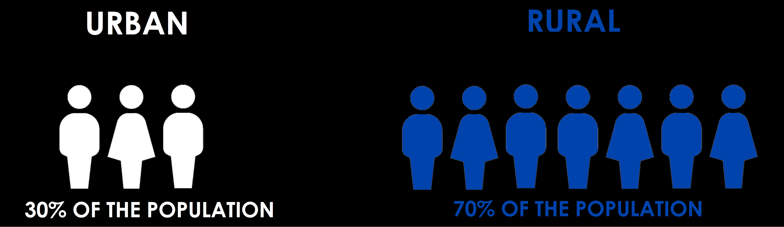
PROBLEM STATEMENT:
Distribution of Indian population
Paramedics use an X-Ray machine to scan the chest region. Considering that rural areas have a myriad of medical cases in addition to the perpetual dearth of healthcare expertise, it can take a while to interpret these images and diagnose the problem. Thereby, it can cause delay in prioritizing urgent patient cases.
In India, only about 24.4% qualified doctors are accessible to Rural areas ( which constitute 70% population of our country).

Slide 6
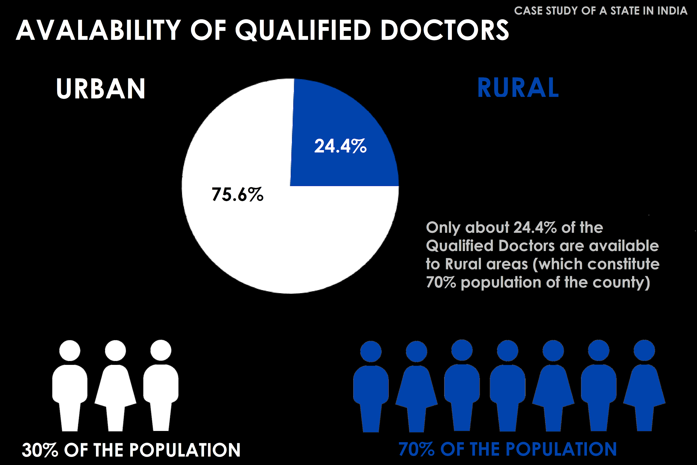
Healthcare in rural India: A lack between need & feed
(Source: South Asian J Cancer. 2014 Apr-Jun; 3(2): 143–144. doi: 10.4103/2278-330X.130483)

Slide 7
FOCUSSING ON THORAX MORTALITY
In 2010, 3.6 million (3.3–3.9 million) episodes of severe pneumonia and 0.35 million (0.31–0.40 million) all cause pneumonia deaths occurred in children younger than 5 years in India. This study highlights the need to improve access to care.
(Source: Burden of Severe Pneumonia, Pneumococcal Pneumonia and Pneumonia Deaths in Indian States: Modelling Based Estimates. Farooqui H et. al.)
Pleural Effusion indicates a high risk of death with 15% of patients dying within 30 days and 32% dying within one year.
(Source: Mortality of patients with pleural effusions - NCBI)
So how can we improve access to healthcare ?
The answer is DATA

Slide 8
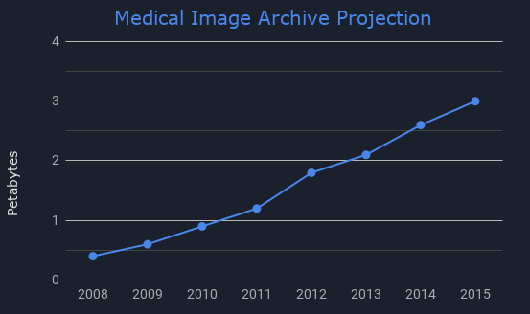
Data availability
Data explosion to reach 35 Zettabytes by 2020 (Source: McKinsey Global Institute Analysis)
Healthcare market is expected to see a 660% increase by 2020 (Source: Enterprise Analytics: Serving Big Data Projects for Healthcare in 2010-2011)
A Chest X-Ray Dataset that has been curated by the NIH (National Institute of Health) can be the necessary impetus providing chest X-ray samples to solve the problem statements discussed above. The NIH Chest X-ray Dataset is comprised of 112,120 X-ray images with disease labels from 30,805 unique patients.
This data can be used to automate detection of thorax diseases using AI, thus, bridging the gap between need and feed.

Slide 9
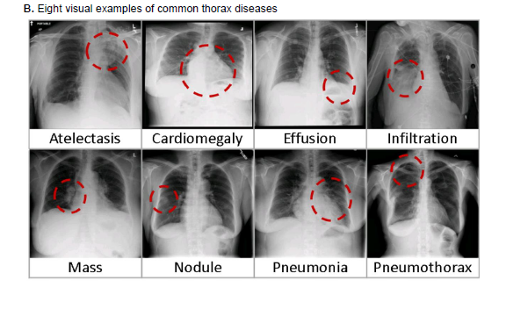
NIH Chest X-ray Dataset
These images can be used to train a deep learning models that will classify each image as “No findings” or one or more of the 14 abnormalities.
This dataset consists of X-ray images in the PNG format with resolution of 1024 X 1024 pixels
The dataset also consists of metadata for all images indicating the index, patient’s age, gender and the view position of the images.
Bounding boxes for 1000 images with [ x , y, w, h ] coordinates is furnished to help with localization algorithms.

Slide 10
SOLUTION:
Harnessing data to deliver quick medical expertise to remote areas.
Our solution to this problem statement is three fold.
Creating an AI algorithm for accurate categorization of chest X-Ray
Building an intermediate device for on-the-spot disease detection
Developing a User Interface to communicate the diagnostic results
Each of the above mentioned steps are crucial to ensure utmost effectiveness of the solution.

Slide 11
Creating an AI algorithm for accurate categorization of chest X-Ray
We propose to utilize Deep Convolutional Neural Networks (DCNN) to accurately categorize the Chest X-ray.
CNNs work by extracting features from an image when furnished with immense labelled X-ray data during the training process.
Initially, we preprocess the image data to reduce the computational expensiveness(which is a direct result of the large size of the image). We reduce the size of the images ( to 128 x 128 or 256 x 256) while retaining their resolution.
These images are passed to the input layer followed by multiple convolutional, pooling, and fully connected layers.
We implemented a similar DCNN to categorize Optical Coherence Tomography images in our research paper here. It won the best paper award at BITS PILANI, 2018

Slide 12
Creating an AI algorithm for accurate categorization of chest X-Ray
The proposed DCNN model will be implemented using the Keras framework with multiple convolutional 2D filters of sizes 32, 64 and 128 at each stage of the network respectively.
We intend to use the ReLU activation function as it does not saturate the gradient and is quick to evaluate in a DCNN
The convolutional layer will be followed by max pool or the mean pool layer of size 3x3 performing pooling operations to obtain spatial invariance.
Dropout regularization between the values 0.3 and 0.5 is employed randomly to increase the effectiveness of the network
The optimizer used is Adam or Stochastic Gradient Descent with a categorical cross entropy loss function.

Slide 13
2. Building an intermediate device for on-the-spot disease detection
If one part of the solution lies in accurate categorization, the solution remains incomplete without expedited Computer Aided Diagnosis.
To achieve this, we intend to interface the NVIDIA Jetson Nano board to either a native X-ray format image (on a system) or the X-Ray machine directly.
The board receives the image in DICOM format (standard radiology image format) and converts it into PNG format.
This image is processed using the pre-trained DCNN algorithm and predicted for the thorax disorders
After analysis of the new image, the diagnostic results are displayed on a User Interface available to the doctor as well as the patient.

Slide 14
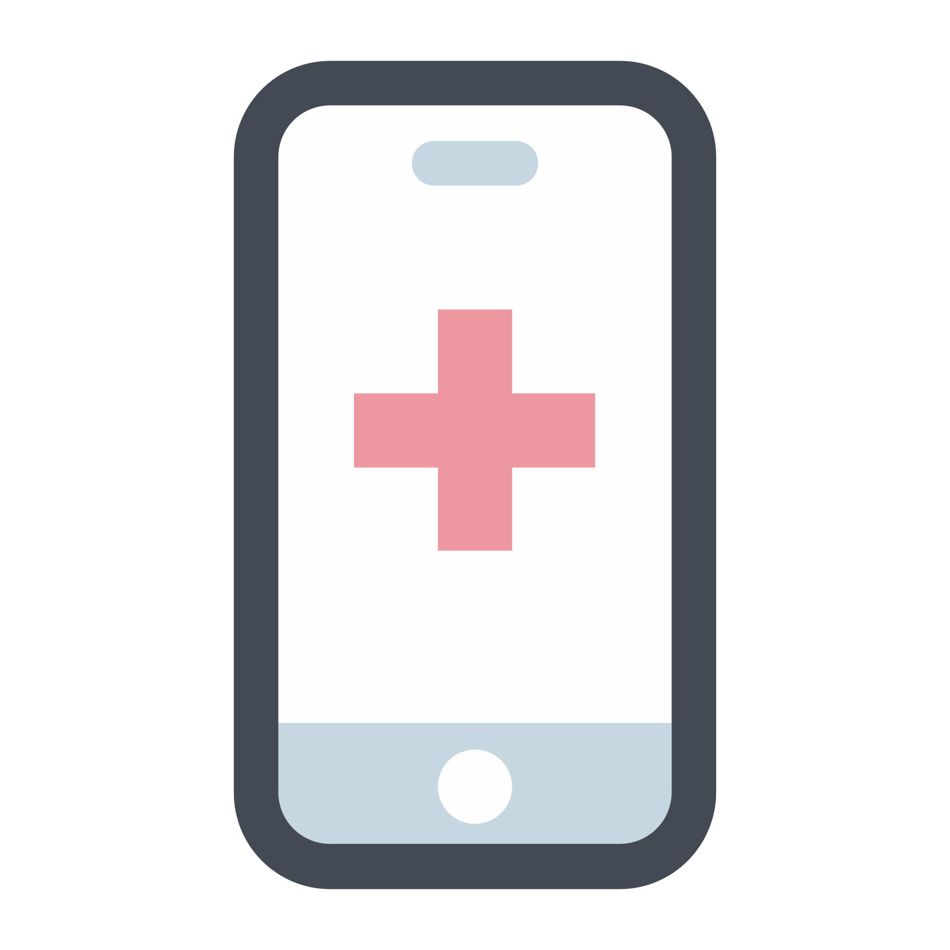
3. Developing a User Interface to communicate the diagnostic results
The proposed UI is a mobile app built using the cross platform Google FLUTTER SDK, featuring MongoDB at the backend.
The app will receive the X-Ray diagnostic results along with the details of the patient.
The app is present at both the terminal ends i.e. with the patient and the doctor to facilitate instantaneous disorder detection and communication.

Slide 15
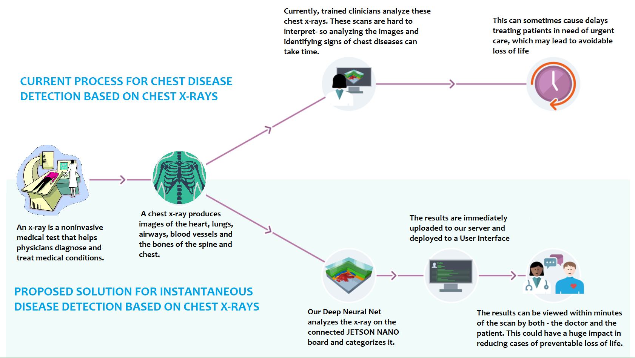

Slide 16
REQUIREMENTS
1 X Server with :
16GB or greater RAM
NVIDIA GPU with compute capability >6.1
Pre-installed Keras with Tensorflow-GPU backend (CUDA 7.0 and CUDNN 9.0)
1 X Jetson NANO Developer Kit with Power Adapter and HDMI monitor
Uninterrupted Power supply and Wi-Fi access with speed >15Mbps

Slide 17
Thank you
Chest X-Ray Computer Aided Diagnosis
Anuroop Mrutyunjay, Pragnya Kondrakunta, P.B. Pranav Kumar
Registration ID: AIH19T-0136
Organization: Osmania University
Mail-id: m98jay@gmail.com

